Slide 1


BOWER HALL
Student Complex
THE OFFICIAL TUS ATHLONE
STUDENT ACCOMMODATION

Slide 2

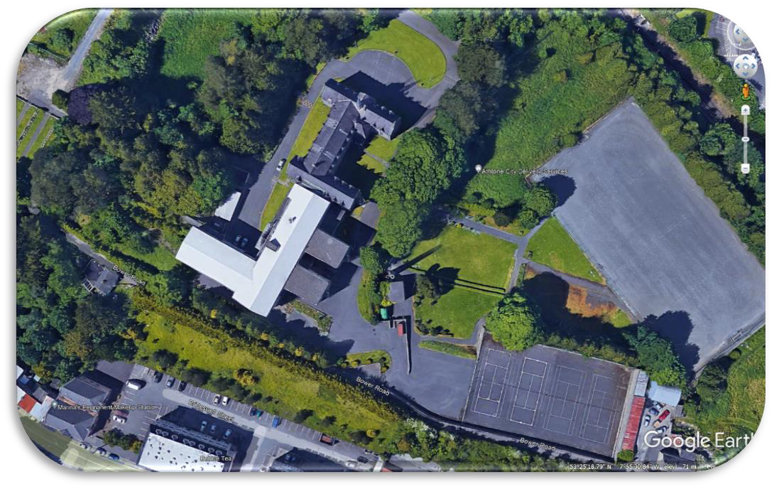
Contents
Introduction
3
History
4
Company Background
5
Location of Property
6
Description of Property
7
What's included
10
What to expect
11
Pricing
12
Payment Details
13
Floor Plans
14
Hanly Group Profile
18

Slide 3
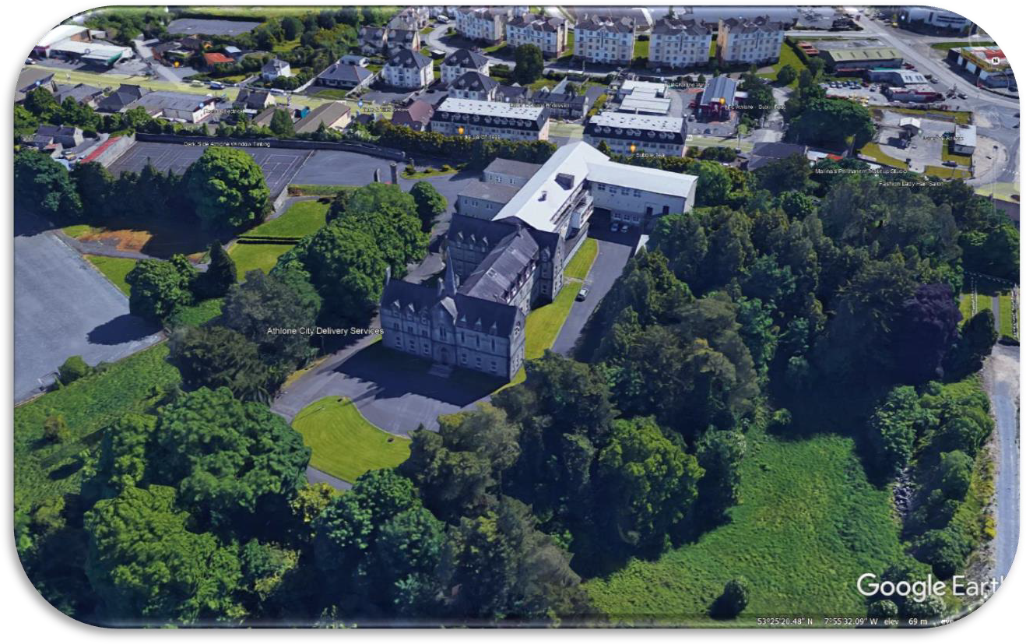
Introduction
Arising from discussions with TUS and based on Market Research the Hanly Group in this submission, are putting forward what we will offer in terms of Managed Comprehensive Student accommodation at Bower Hall formerly Our Lady’s Bower Convent Boarding School.

Slide 4
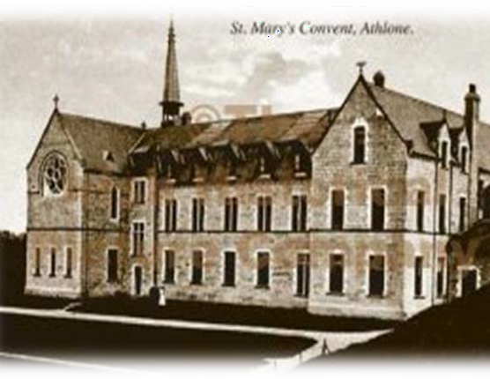
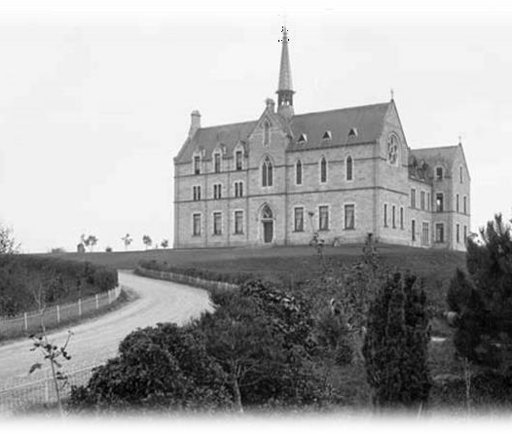
History
Our Lady’s Bower Boarding School was established in 1884 by Fr. Jean-Baptiste Debrabant, who founded Le Sainte Union De Sacre Coeurs. The congregation of Le Sainte Union & Fr. Debrabant ministered the spiritual and educational needs of children in the aftermath of the French Revolution and Napoleonic wars.
By 1863 Le Sainte Union Sisters had opened a school for girls in Banagher, Co. Offaly. In May 1884 a small group of Sisters took possession of their newly built Convent on the esker on the eastern edge of Athlone.
Until 2015 the school was both residential and day students and had accommodation for up to 200 girls and Le Sainte Union Order residing in the Convent. The school attracted students from the midlands and beyond as well as from Europe and overseas, enhancing the school’s cosmopolitan hue.
The Bower complex comprises an aesthetically attractive gothic cut-stone building on an elevated site overlooking the town of Athlone with views of the River Shannon, the surrounding countryside and on the horizon, the ancient monastic site of Clonmacnoise. The building is an imposing structure with many original features including a pitched natural slate roof with decorative clay ridge tiles, ashlar limestone chimneystacks and pediment half dormer windows with stained glass.
The former convent comprises a large extension which was formally accommodation for the girls boarding school. Due to the dwindling numbers in the La Sainte Union Order, the residential aspect of school and property was closed in 2015.
The Hanly Group purchased the property in 2017 and set out about the rejuvenation of same.

Slide 5
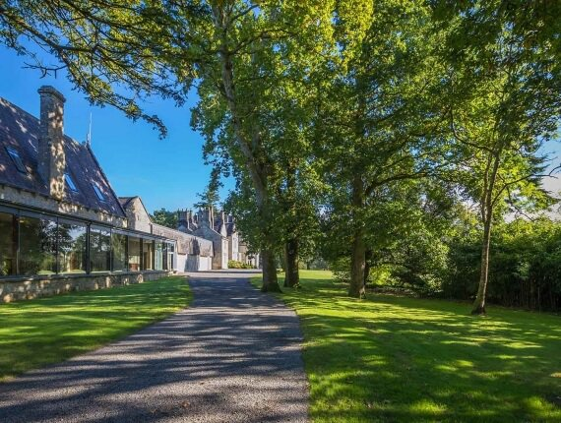
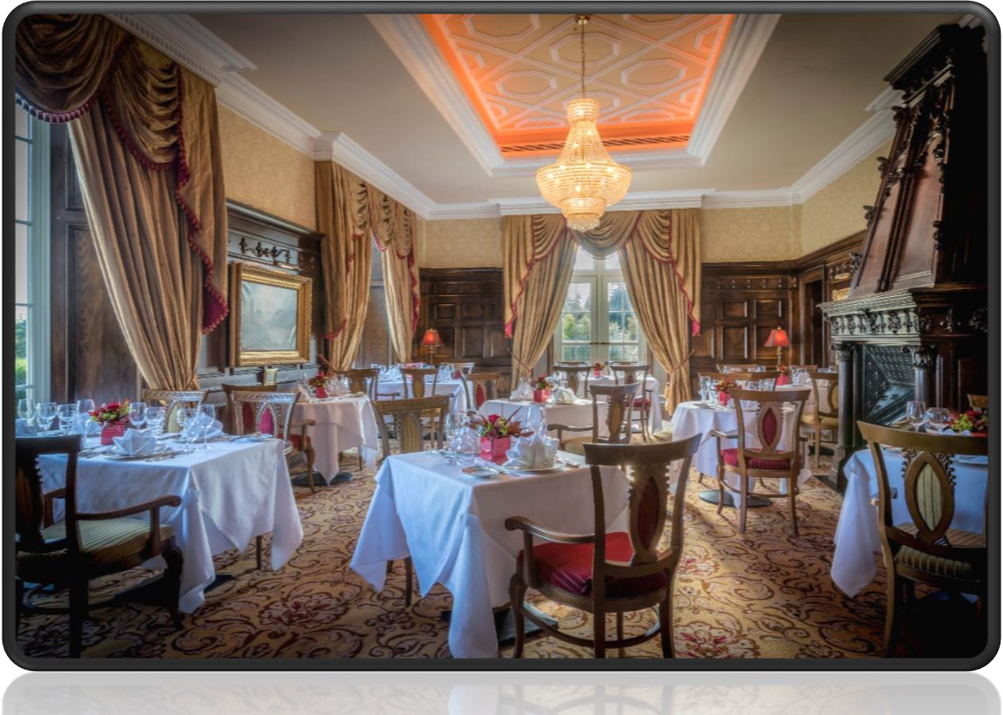
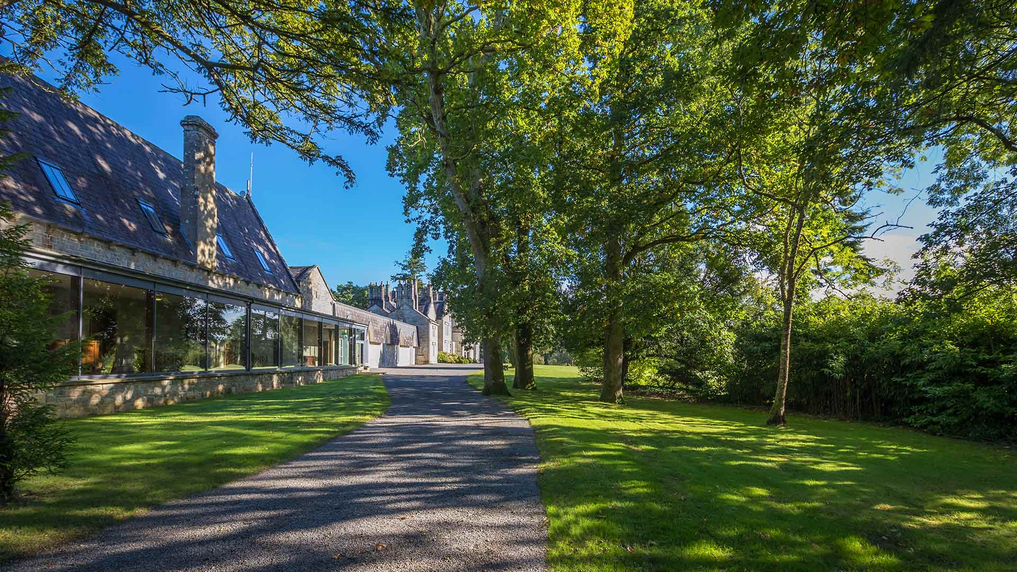
Company Background
The Hanly Group is involved in the quarrying, construction, development and hospitality sectors. The company employs over 400 people in our quarry, construction & paving division and two luxury multi award winning hotels. All elements of the required expertise to formulate this proposal exist within the Group and this proposal is made drawing on same.

Slide 6
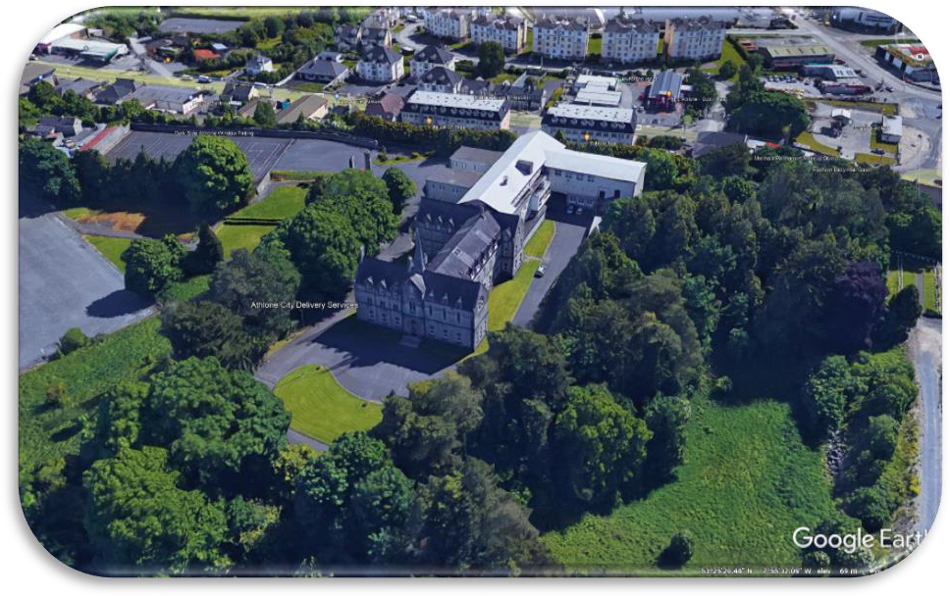
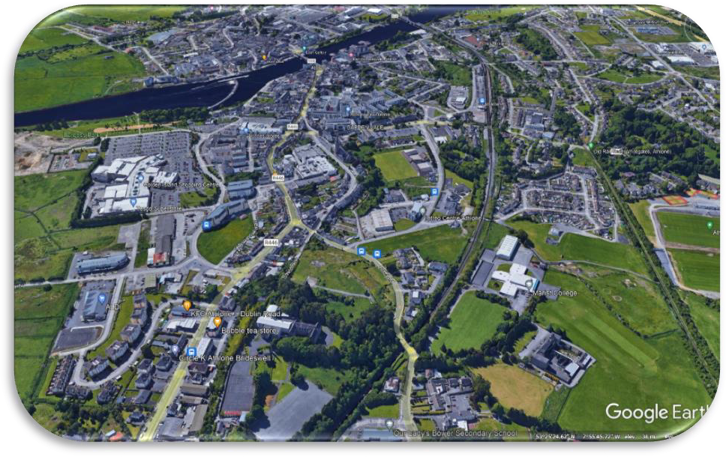
Location of Property
Bower Hall Student Complex, is located on Retreat Road, while providing secure outdoor activity on its wood land grounds of 7.5 acres, is in walking distance of the center of Athlone town and all retail amenities as well as medical and educational facilities that would could expect in a regional town.
The Facility sits on an elevated site in the center of Athlone. It is close to both shopping centers Golden Island Shopping Centre and Athlone Town Shopping Centre. Athlone has excellent sporting facilities as well as a bustling nightlife. There is a bus stop outside the entrance directly to the TUS with half Hourly collection times. The facility is also a short 15-minute walk or a 7-minute Bicycle ride.
Local Sports facilities include
Pool
Park
Pitch
Reginal Sports Centre
Local shopping Facilities include
Athlone Shopping Centre
Golden Island Shopping Centre
Town Centre Shopping

Slide 7

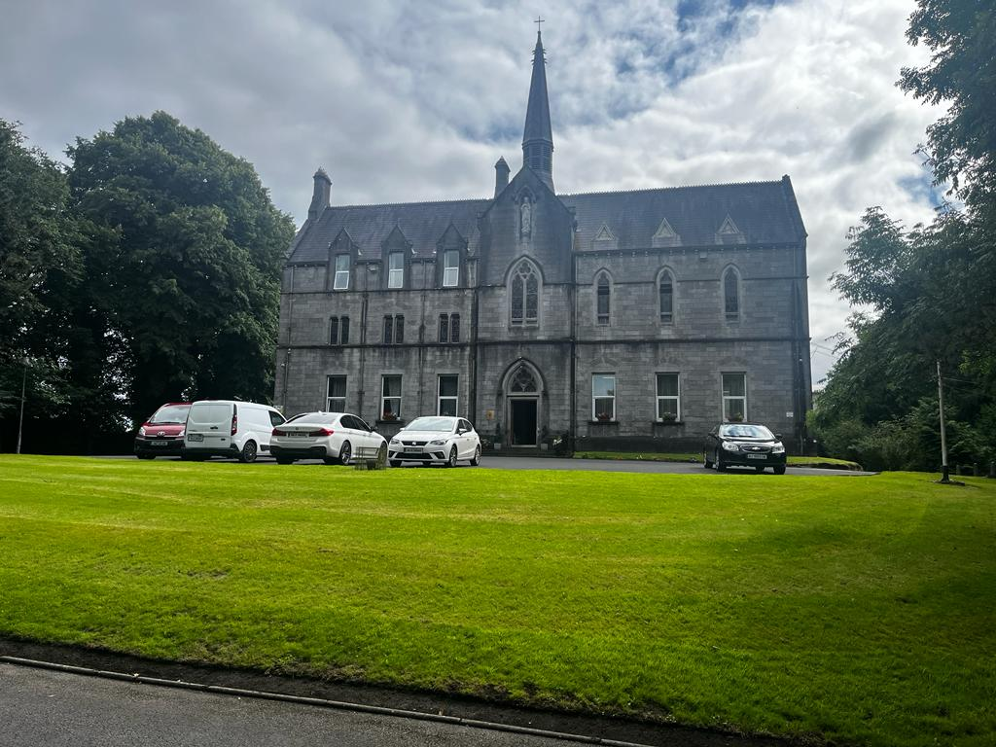
Description of Bower Hall TUS Student Village
Bower Hall grounds boasts the following facilities: -
Externally
There are approximately 7 acres of open space on the facility comprising: -
Private Grounds with mature gardens
Wooded walkways
Outdoor seating and relaxation areas
Tennis Courts (4) of which two are converted for use as basketball courts. The four tennis courts can also act as a hard surface football pitch.
Onsite Secure Parking
Internally
The Bower building itself has a large footprint with significant common areas to allow for the movement of people which would not be available in private rentals.
The Facility is connected to all utilities and has a fully integrated and operational serviced fire alarm.
Facilities include :
- Three dedicated Study Rooms
Unlimited highspeed Broadband
Large common room with Internet TV, Table Tennis, Pool table & Games Consoles
On-Site Laundry and Ironing Facilities
Large bright fully equipped self-catering kitchens with Dining room
24-hour Management and Security
Reception Open daily 7 days per week
Fully protected by CCTV internally and externally
Oil fired central Heating along with high-end Infrared heating in some areas
Bower Hall Student complex is custom designed for the now proposed use and would be considered high end accommodation in a prime location providing an excellent quality of life amenity for 3rd level Students.
7

Slide 8

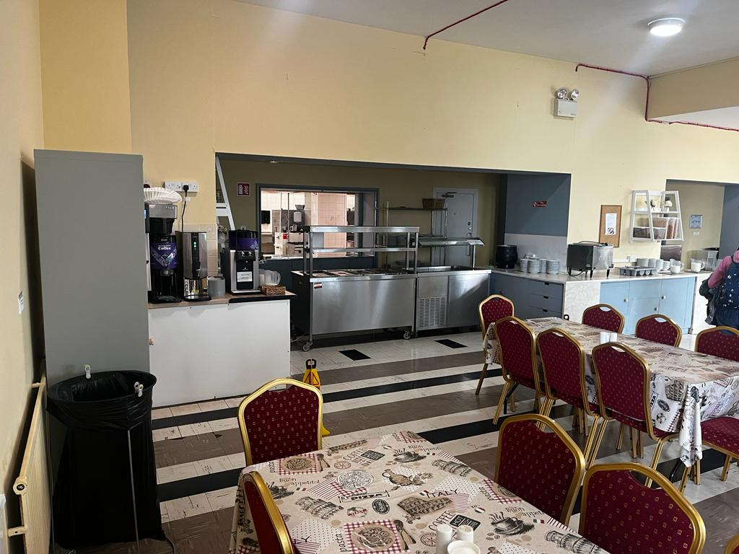
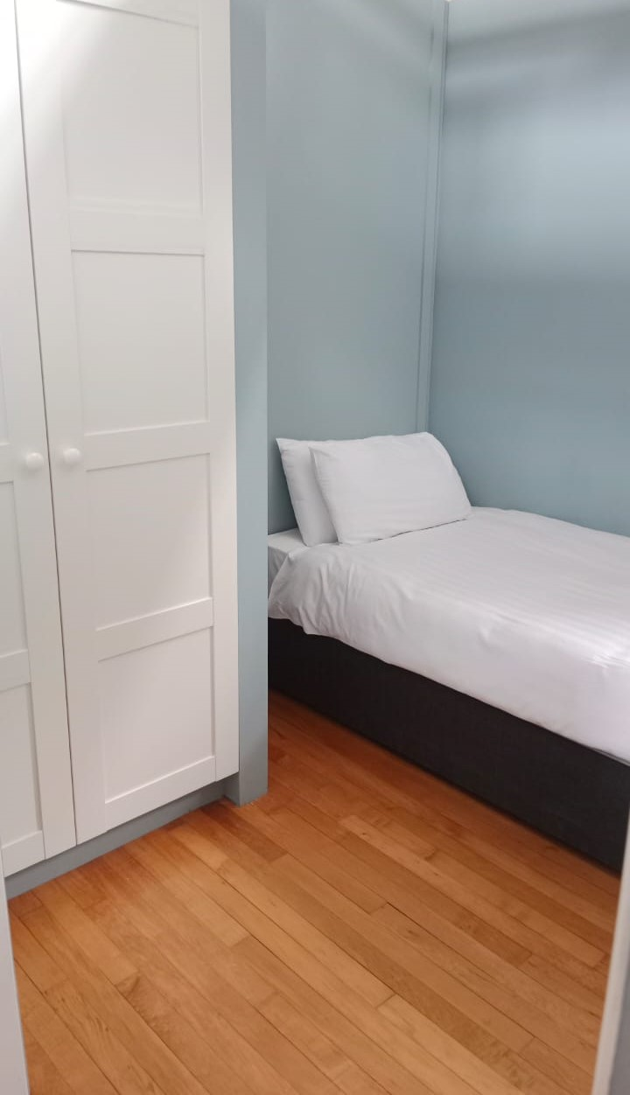
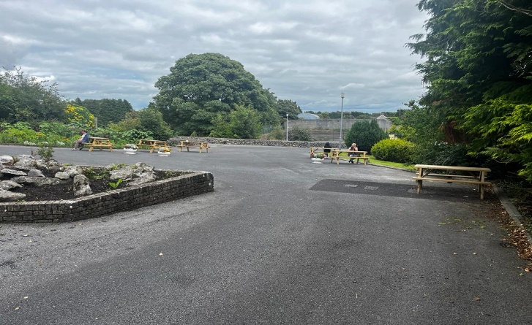
Large Self-catering dining hall: Fully equipped with Induction hobs, Microwaves, Tea/Coffee making facilities. All pots, pans, utensils and crockery provided
Social room: with ample seating and Internet TV, Table Tennis, Pool table & Games Consoles
Three Dedicated Study rooms: All with large windows allowing for natural light and fresh air. Equipped with Highspeed broadband, Study tables and Chairs
Private study rooms: Available for individual use for exam or solo study
Sleeping accommodation: – this is divided into single rooms, Shared rooms, dormitory style rooms with full divisions and lockable doors. Each bed space includes Wardrobe, Desk, Chair, locker and bedside lamp.

Slide 9
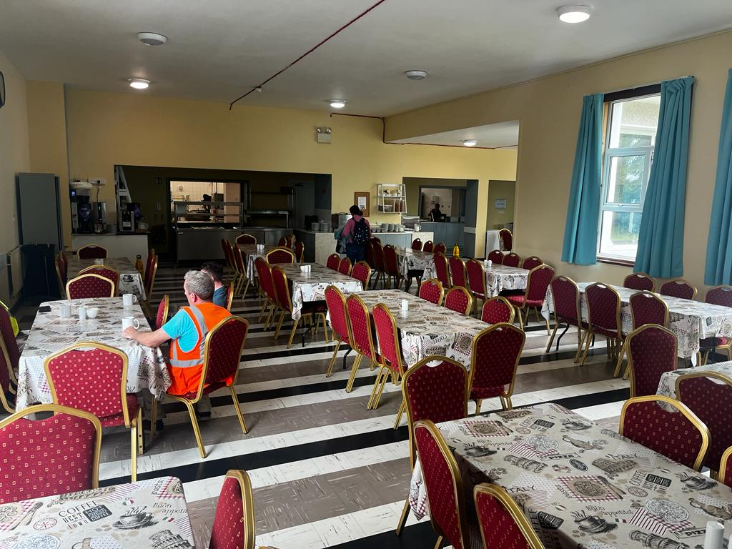
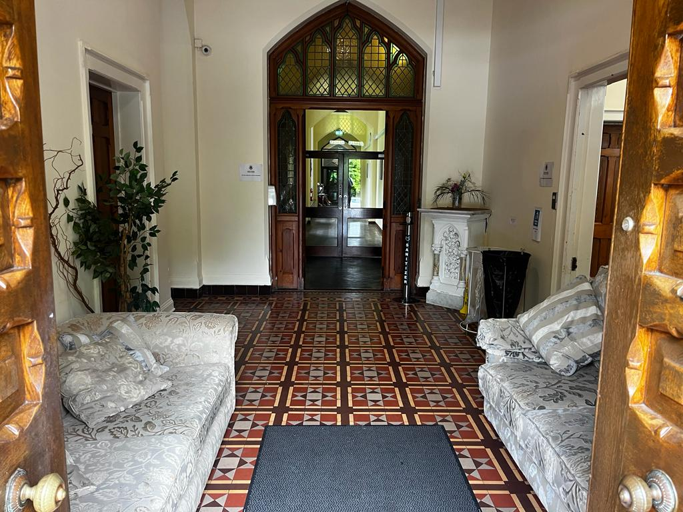
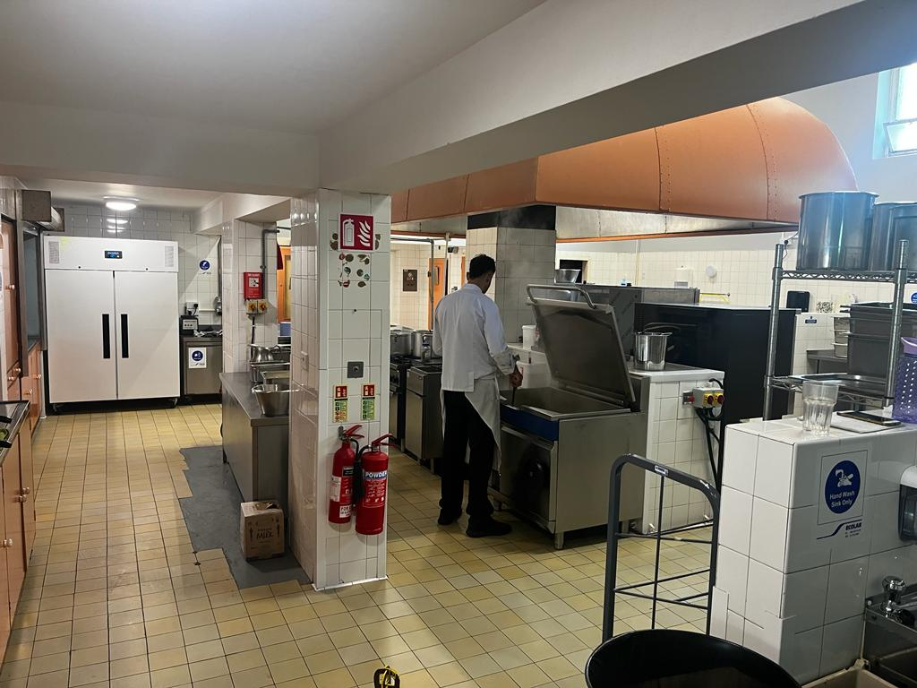
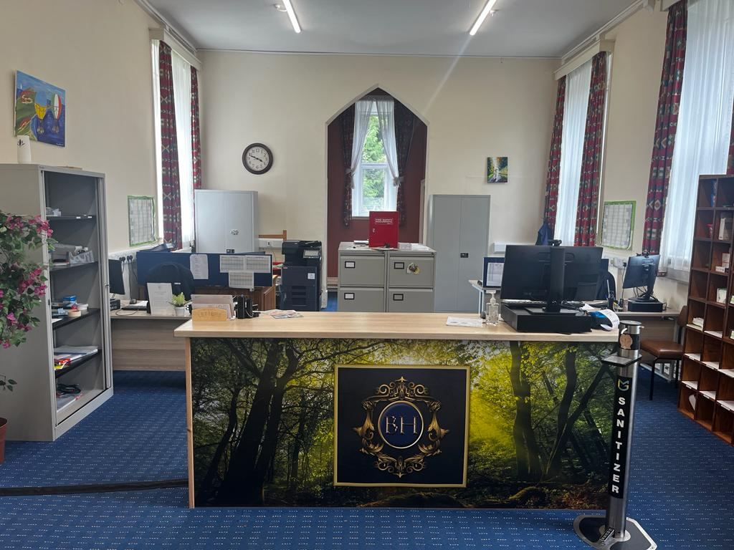
.
.
.
.
.

Slide 10
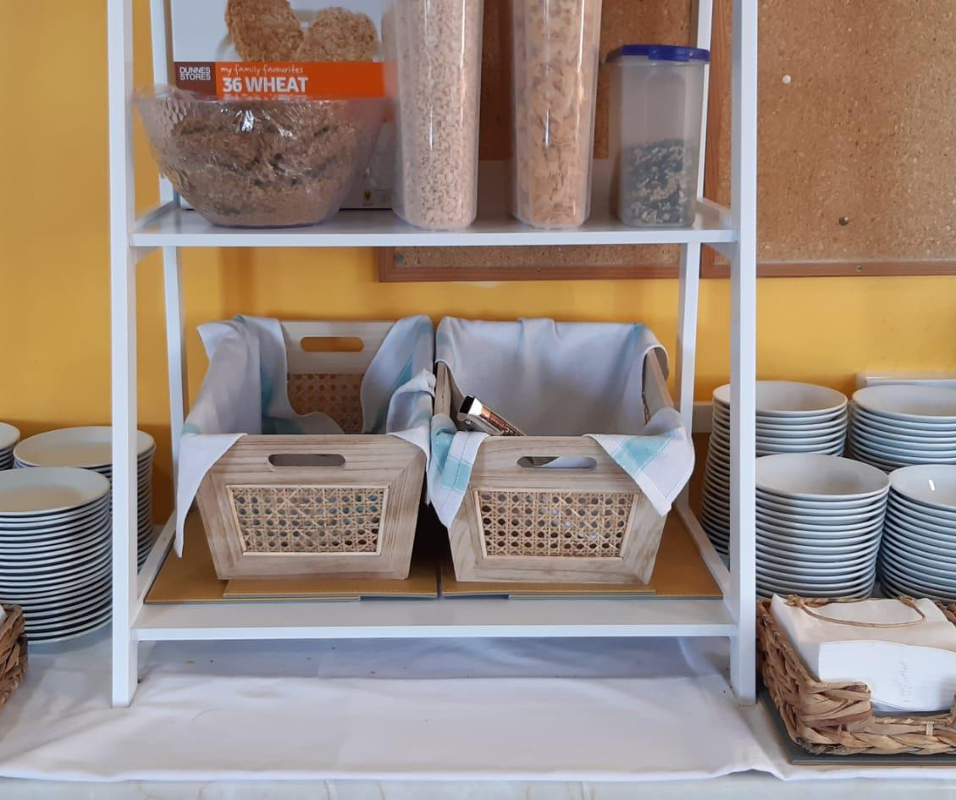
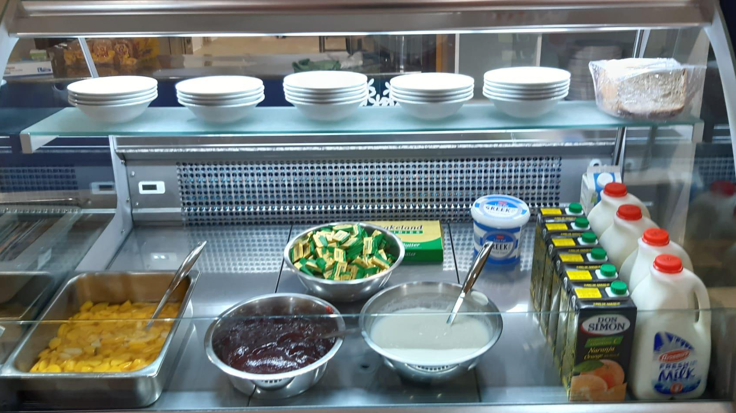
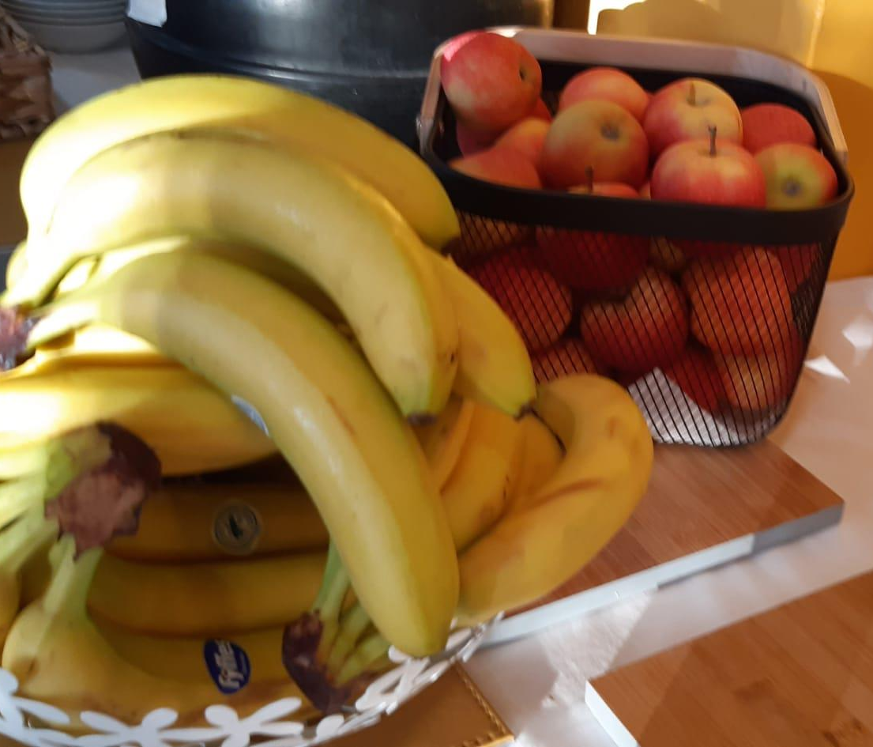
What’s Included
The following services are included in your package:
Single Bed in Private Dorm, Shared room or Twin Rooms. Limited Double beds available for Single occupancy
Individual Study Desk with Chair, Wardrobe, Locker & Lamp
Housekeeping Services for all rooms & common areas including the supply and weekly change of bed linen and towels
Duvets & Pillows supplied
Unlimited Highspeed Broadband throughout the building
Fully equipped Self-catering kitchens with induction hobs, Pots, Pans, crockery and utensils provided
* Token operated washing machines/dryers for personal clothing
All utilities included
*Printing and Photocopying service available
Onsite Management, security and operational staff.
Ongoing building maintenance.
Free Private Parking subject to availability.
* - Additional charge

Slide 11


What to expect when living in residence
When you live in our Student Complex, you can expect:
• Professional management service whose primary focus is to deliver the best student living experience
• Support during your journey at 3rd Level
• Excellent facilities across and local amenities
• No additional hidden costs.
Who will I live with?
At Bower Hall, we have an allocation policy which we believe encourages vibrant communities. Our residents can expect to live with students in the same year. You will find that students may be completing different courses to you which creates diversity. Our accommodation is mixed gender with equal balance where possible.
Can I apply before I get my Collage offer?
All applications are based on a lottery system. There is no guarantee that you will be offered a place. Applications are free of charge. If you are offered a space, a non-refundable fee of €50 applies to hold your space pending your CAO or collage application results payable within 7 days of you offer of accommodation. If you are not successful in your collage application, you must inform us within three days of the First Round of CAO offers or your accommodation offer will be with drawn. We can add you to a wait list.
Can I request a room type?
On the application form you can select your preferred bedroom type, but this room cannot be guaranteed. Please read the room rate fees before selecting your room preference.

Slide 12
Accommodation Pricing 9 months. Sept to May
2025 / 2026 Academic Year
Private Single bedroom € 8010
Private room Double bed – Single Occupancy € 8100
Twin Room – Sharing with 1 other €6120
Single Sharing with 2 others €5490
Single Sharing with 3 others €5220
Private Dorm Room €6480
Deposit of €800

Slide 13
Payment Details
 | Payment 1 | Payment 2 | Payment 3
*Up-front Single Security Deposit | €800 | - | -
Private Single bedroom | €2670 | €2670 | € 2670
Private room Double bed – Single Occupancy | €2700 | €2700 | € 2700
Twin Room – Sharing with 1 other | €2040 | €2040 | €2040
Single Sharing with 2 others | €1830 | €1830 | €1830
Single Sharing with 3 others | €1740 | €1740 | €1740
Private Dorm Room | €2160 | €2160 | €2160
5% Discount
if full year
is paid upfront
13
*Security Deposit Held for Full year

Slide 14

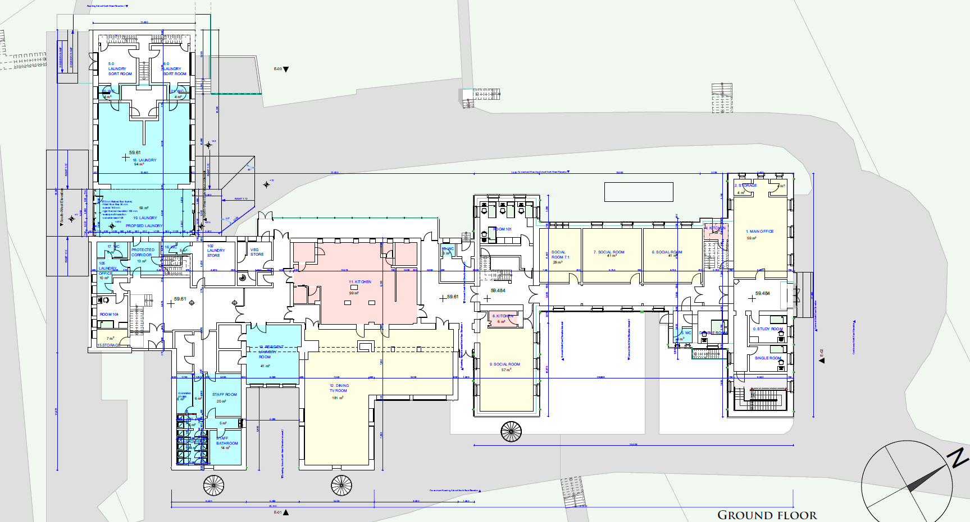
GROUND FLOOR

Slide 15
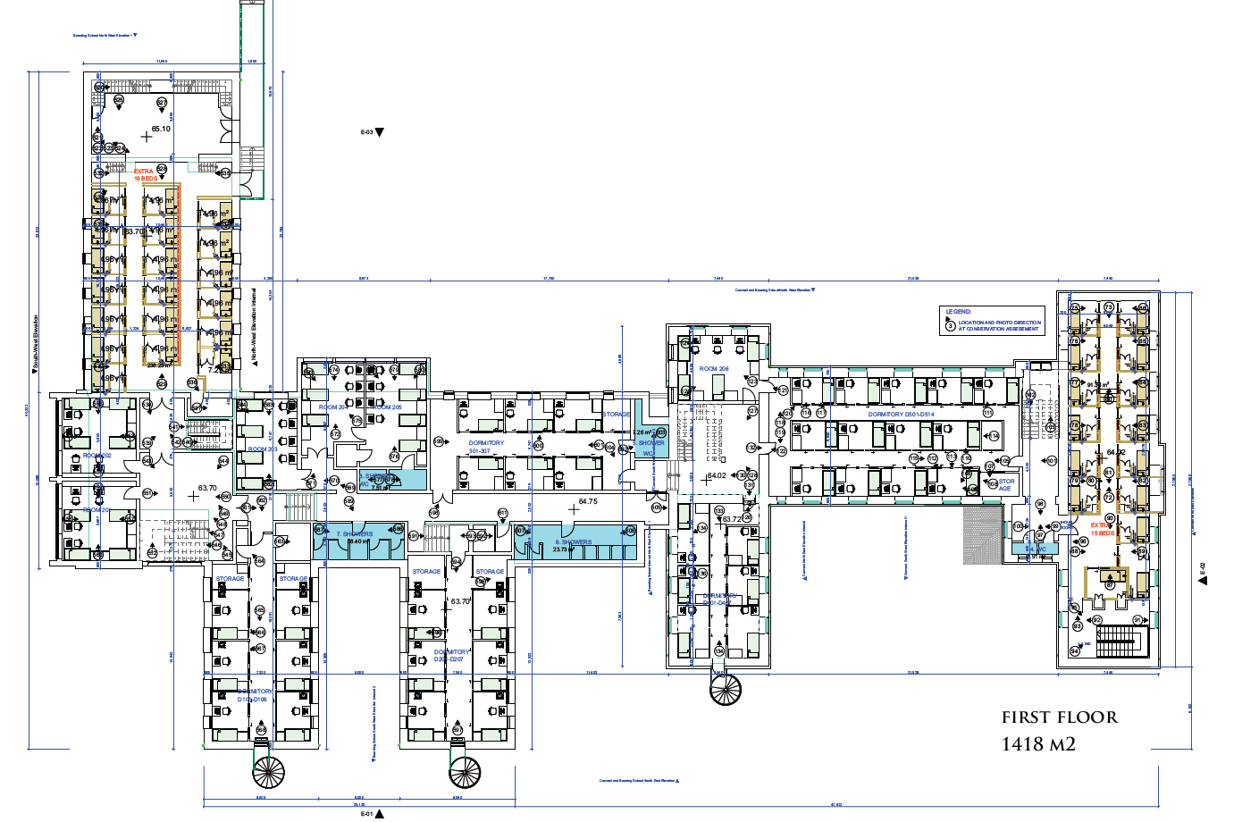
FIRST FLOOR

Slide 16
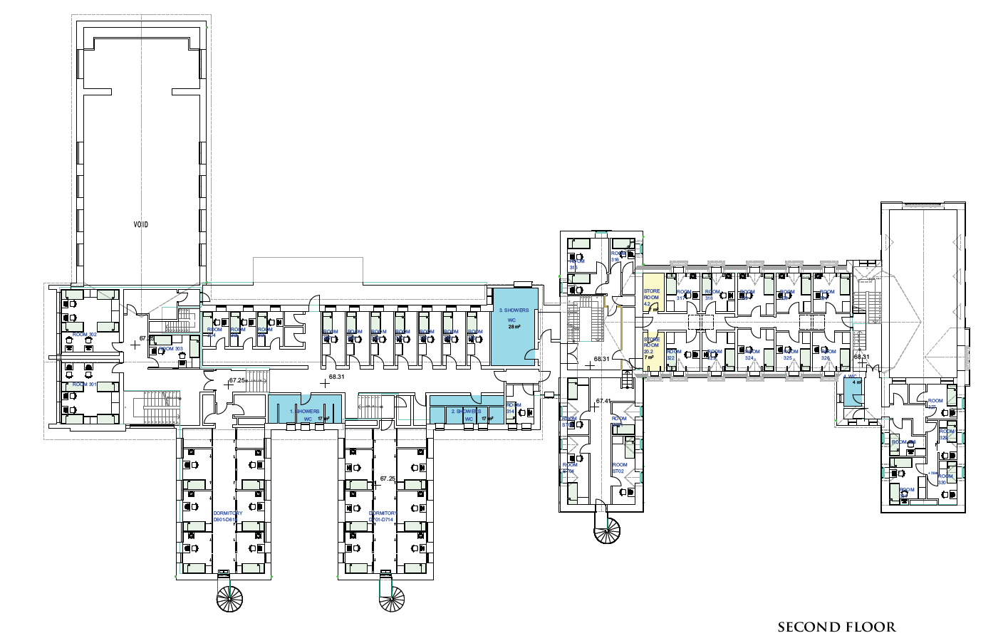
SECOND FLOOR

Slide 17
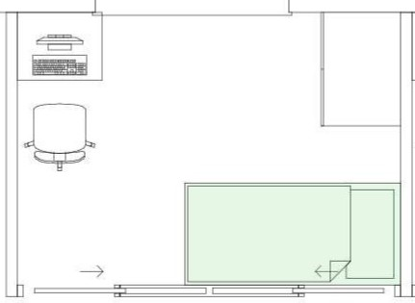
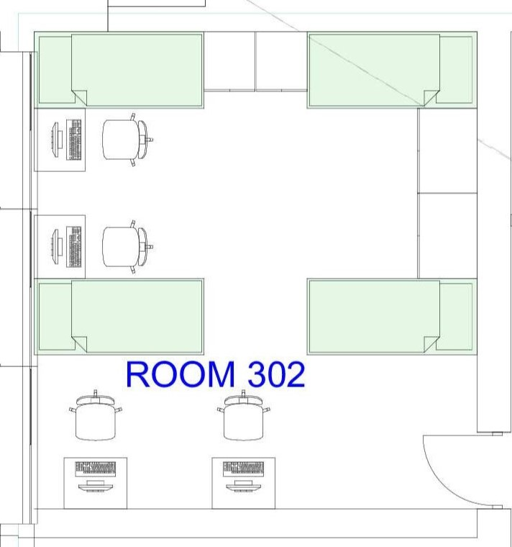
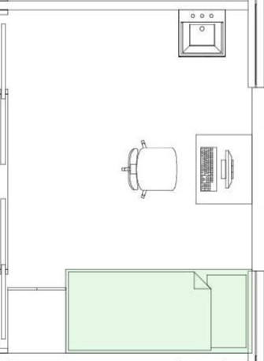
ROOM LAYOUTS

Slide 18
Hanly Group Profile
The Hanly Group has been particularly successful in the developing and restoration of historic buildings to sustainable modern uses while rejuvenating and enhancing all of the historical building's details and architectural.
The Hanly Group restored Lough Rynn Castle from a derelict building to its finished product today.
Other projects included the restoration of Kilronan Castle, a semi-derelict building, to a finished hotel.
The Hanly Group has been successful in quarrying, construction and the hospitality business and in the latter years built in excess of 2500 residential units in addition to hotel complexes and over 1,00,000sqft of office and industrial developments.
The company possesses in-house expertise and know how to progress Bower Hall from its current facility to a high-end operational quality Student accommodation complex.

Slide 19


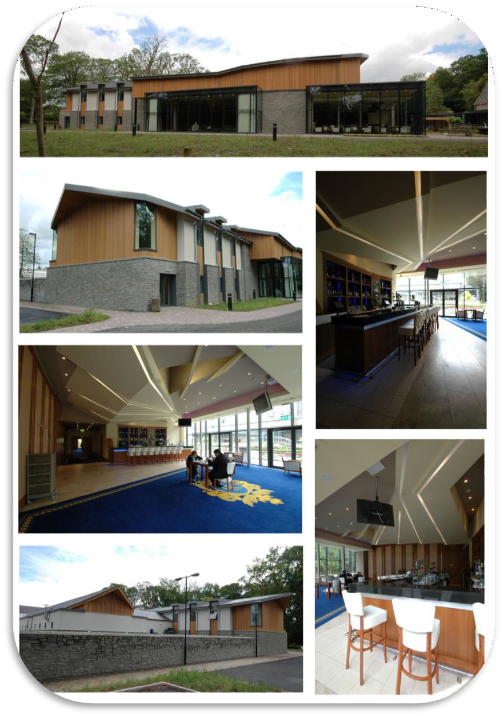


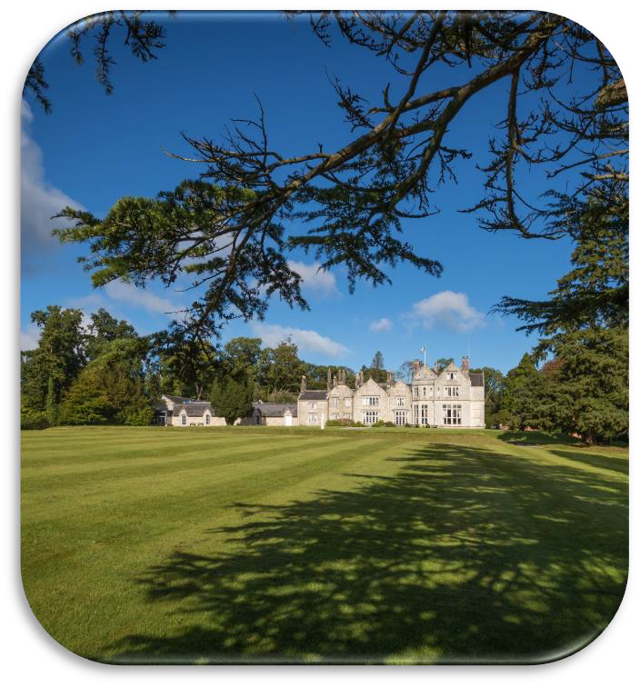

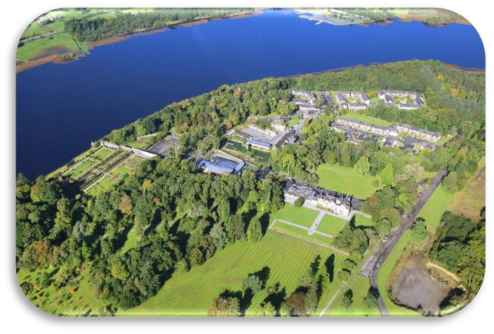
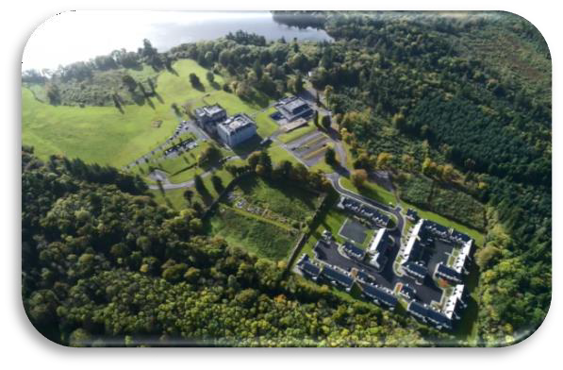
Lough Rynn Castle Hotel, Co. Leitrim
Kilronan Castle Hotel, Co. Roscommon

