Slide 1
Welcome to Mgts 312
Instructor – Allan Wesley

Slide 2
Introduction
Enterprise of the future -> based on empiricism and analytical decision making
  For example, Fastest growing are of enterprise software– human capital management – see Paycom Software and Paylocity
  Many hedgefunds use algorithmic trading. One, Bridgewater is going even further…..
  https://www.wired.com/story/ray-dalio-principles/
We will learn the basic tools to utilize continuous analysis of past business performance and events to gain forward looking insight to drive business decisions and actions.
Note business that have not yet adopted predictive technologies experience a 2% decline in profit margins and a 1% drop in customer retention rate.

Slide 3
HR data analytics
Example questions include:
How high is your annual employee turnover?
How much of your employee turnover consists of regretted loss?
Do you know which employees will be the most likely to leave your company within a year?

Slide 4
Legal Analytics
Streamlining Discovery – understanding relationships and patterns in files, identifying more relevant documents.
Recognizing “ideal” clients
Predictive analytics – likelihood of winning, length of litigation, required hours.
Lawyer productivity

Slide 5
Statistical Inference and the Normal distribution
sampling distributions
central limit theorem
z Table

Slide 6
objectives
  Central Limit Theorem and inference
  Define “standard normal”
  Use probability tables
    Applications:
      Sample outcome
      CI and hypothesis testing
Notes:
Important: Recognize when to apply the Central Limit Theorem (and use z in inference)

Slide 7
Statistical Inference
random samples population
statements about the degree of uncertainty
Convenience samples and other non random samples cannot be used to make statistical inferences.

Slide 8
Population Distribution
all items in the population of interest
characterized by the values of certain parameters which are usually unknown

Slide 9
Statistical Inference
Two types of inference procedures
  Estimation
  Hypothesis Testing

Slide 10
Random Sample
All individuals or objects in the population have a chance of being selected
The selection of any one individual or object does not affect the selection probability for any other individual or object

Slide 11
Simple Random Sample
A random sample selected in such a way that all possible samples of the same size have the same chance of being selected
Implies that all individuals have the same chance of being selected for the sample
Notes:
There are other methods other than SRS for gathering samples. More sophisticated techniques are often used to reduce error or allow for smaller sample sizes at a given level of error.

Slide 12
Finite Populations and Sampling With Replacement
If the sampling fraction n/N ( where N is the population size) is less than 5% then we ignore the finite population effect
If the population is small and sampled without replacement, finite corrections have to be made (not to be discussed in this course)
Notes:
If the sampling fraction n/N ( where N is the population size) is less than 5% then we ignore the finite population effect
If the population is small and sampled without replacement, finite corrections have to be made (not to be discussed in this course)
------
If n/N > 0.05 see equation 7.5 on pg 290 of the text to calculate the standard deviation of the mean.

Slide 13
Normal Distribution – Some Basics
Follows a symmetric bell shaped dist.
Has 2 parameters that “define” the dist’n i.e. we need these parameters to conduct normal probability calculations.
µ = mean
σ = standard deviation
We use z-scores to standardize the normal distribution – so that we can use one set of z tables for all normal prob. calculations

Slide 14
Z-score
Z= (x-µ)/σ
This will standardize our normal dist’n so that the mean is 0 and the stdev (standard deviation) is 1.

Slide 15
Example: Start with a population of interest…
Population Distribution
X the random variable
μ population mean
σ² population variance
To be discussed later, but think – must the population distribution be normal?

Slide 16
Draw a series of random samples, each of size n from the population…
Population Distribution
X the random variable
μ population mean
σ² population variance
draw samples
Sample 1 of size n
Sample 2 of size n
Sample i of size n

Slide 17
Sampling Distribution
What You Do
What You Imagine
The population
The population
The sample
The sample
The sample
…
The sample
A statistic
A statistic
…
A statistic
The statistic
A histogram of these values represents, approximately, the sampling distribution of the statistic
Notes:
Sampling distribution
This is the distribution of a sample statistic over all possible samples of the same size taken from the same population
Knowing the sampling distribution of our sample statistic allows us to make probability statements about the degree of uncertainty in our answers
If we wish to make inferences about a population mean using a sample mean we require the sampling distribution of the sample mean

Slide 18
Standard error
The standard deviation of the mean
is called the standard error of the mean
Notes:
Standard error of the sample mean
As the sample size n increases, the variation of the sample means around the true mean decreases
Each sample statistic has its own sampling distribution, with an expected (mean) value, variance and standard error.

Slide 19
Central Limit Theorem (CLT) aka Sampling Distributions
One of the most important theorems in stats.
Essentially states that if random samples of n observations are drawn from a population with a finite mean, µ, and standard deviation, σ, then:
  When n is large, the sampling distribution of the sample means is approx normally distributed, and
  Std dev of the mean is σ ⁄ √n.

Slide 20
Central Limit Theorem (CLT) aka Sampling Distributions
In nice short notation→CLT or sampling distribution becomes
Now we need to consider what is “n is large”

Slide 21
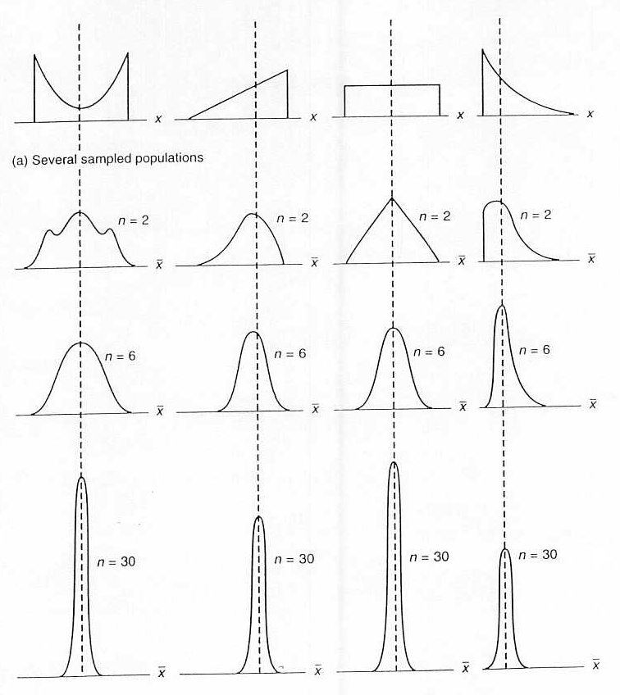
Central Limit Theorem

Slide 22
Central Limit Theorem
What is a “large” sample?
In most situations – when
heavily skewed populations?
Notes:
assume the central limit theorem holds for
For smaller samples we might assume the central limit theorem holds if we believe that the population distribution is not that different from a normal
---------------
Usually with quantitative random variables we assume the central limit theorem holds for samples of size 30 or more
For smaller samples we might assume the central limit theorem holds if we believe that the population distribution is not that different from a normal

Slide 23
An Example
According to credit monitoring firm Equifax the average consumer debt for Albertans was $24,439 (Q2, 2023) and assume that the pop’n standard deviation was $5000
a) What is the probability that in a random sample of 36 accounts the average non-mortgage debt exceeds $25,056 (the level from a couple of years ago)?
Notes:
When you see the word “probability” and “average” or “mean” in the same question likely you are going to be applying the CLT.

Slide 24
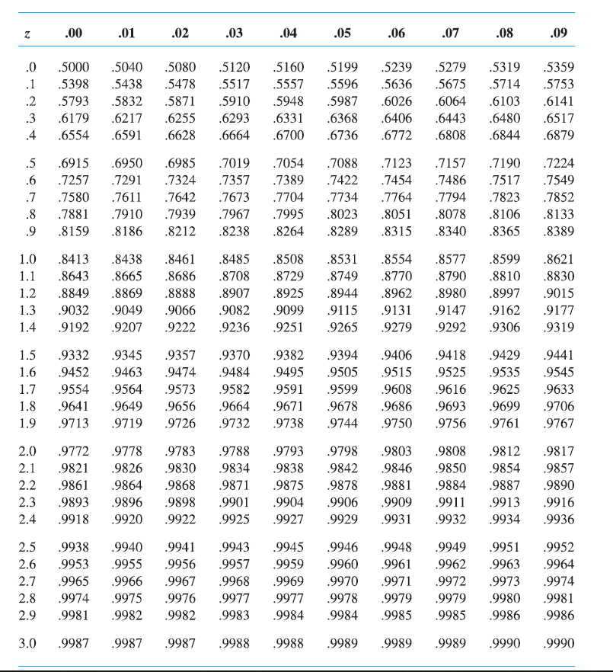
Normal Distribution Table
(from Mgts 103)
Provides area to left of a given z value

Slide 25
Example 1 solution
The stdev for means is
Applying the expression:
25056-24439
=0.74
Z =
24439 25056
x
P[ Z > 0.74 ] = 0.2296

Slide 26
Example 1b): try this yourself
What is the probability that in a random sample of 49 accounts the average debt is between $24000 and $27000?
Use norm.dist() in Excel
Can also use tables.

Slide 27
Commuting times: Example 2
According to StatsCan, the average daily vehicular commute time in Edmonton is 46 minutes. Assuming commute time follows an exponential distribution (not unreasonable) the standard deviation is
If we survey commuters, find the probability that the average commute time is less than
Notes:
88 minutes for public transit

Slide 28
b) If the sample size were 49 what would be the probability in the previous question?
  Adjust the standard error in the z calculations…
46
x
…and find probability of a difference
in excess of 2 minutes =

Slide 29
Normal Distribution Table
(from Mgts 103)
Provides area to left of a given z value

Slide 30
Some More Practice Questions
The life expectancy of a particular brand of hair dryer has a mean of fifty months and a pop’n standard deviation of eight months.
  What is the probability that a random sample of 16 hair dryers will have an average working lifetime of more than 52 months?
  What is the probability that a random sample of 64 hair dryers will have an average working lifetime of more than 52 months?
  Ninety-five percent of this brand of hair dryer will have an average life expectancy of at least how many months (use sample from b)?

Slide 31
Normal Distribution Table
(from Mgts 103)
Provides area to left of a given z value

Slide 32
